Slide 1
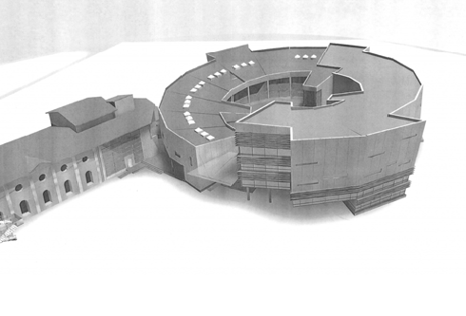
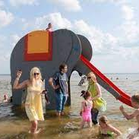
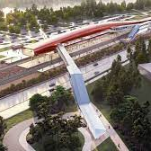
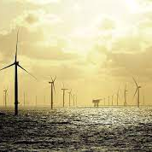
mobility
infrastructure
entrepreneurship
tourism
innovation
education
personalised services
energy
Together With New Energy
Pärnu County vision 2035+

Slide 2
Strategic focus area: science-based economy
Objective: Strong, innovative and responsible economy
Keywords: sustainability, cooperation network, support systems, attractive business environment, marketing and brand
Competitiveness of the economy (innovation, incubation, competence)
Entrepreneurial awareness and well-prepared and qualified workforce qualified: entrepreneurship + education, students’ careers linked to countys’ needs.
Knowledge transfer: Qualified human capital one of weaknesses = difficult to support the transition to a knowledge-intensive economic structure

Slide 3
KOBAR / CLUSTER
(“BUNCH”)
A solution for the changing environment:
Self-learning, network-based, flexible, social, informal, decentralized, competence-based learning organization model, open innovation approach,
Need for operating environment creating new layers of capabilities and resources
Entrepreneurial cooperation platform:
Entrepreneurs, business support structures and educational institutions
Jointly solving challenges to grow business opportunities and develop the region

Slide 4
Triple Helix Regional Innovation Centre
Resource economy
Consulting
Youth entrepre-neurship
Labs
MULTI-VERSITAS
Service Design
Business Incubation
Business support
Thematic clusters
Place marketing
Enterprises
Public Sector
Education
KNOWLEDGE TRANSFER

Slide 5
KOBAR as regional open innovation hub
Enterprises
Networks
Educational/ research institutions
Local municipalities
Public sector support structures
Communities
AMPLIFIER
Investment into strategic R&D development
CLUB
co-creation, co-design
EXPERT
Need-based actions
PARTNER
basic capacities and actions

Slide 6
Funding by state: Attractive regional business and living environment Project Pärnu County Innovation Hub/Centre KOBAR
County Development Centre
Content Activities 1.7 M
College
Investment 0.8 M
College
Content Activities 1.5 M
Topical KOBARs
Research
Innovation (R&DIE support)
Multiversitas
Youth entrepreneurship
Design Lab
Business incubator
Project management master class

Slide 7
Expected outcome
The regional innovation center based on the 5-helix model (science, business, public sector, civil society and environment) supports the sustainable development of the region by encouraging extensive sharing of knowledge and resources and close cooperation between different stakeholders, leading to the growth of innovation, increased community involvement and strengthening of economic dynamics:
More effective social network and information exchange between entrepreneurs
Interdisciplinary support services (training, contacts, consultation, incubation, etc.) throughout the entire business life cycle
Expanding R&D opportunities for small and micro-enterprises
A modern meeting place in form and content to promote cooperation between entrepreneurs, the education sector, communities and the public sector
Growing ability to attract EU, state and private investment and development funds
Systemically designed public and business services
A functioning and developing regional business ecosystem
Enrichment of the local educational supply, increase in options

Slide 8
Development of UT Pärnu College into a regional innovation campus

